Slide 1

Project 15
Team 3

Slide 2
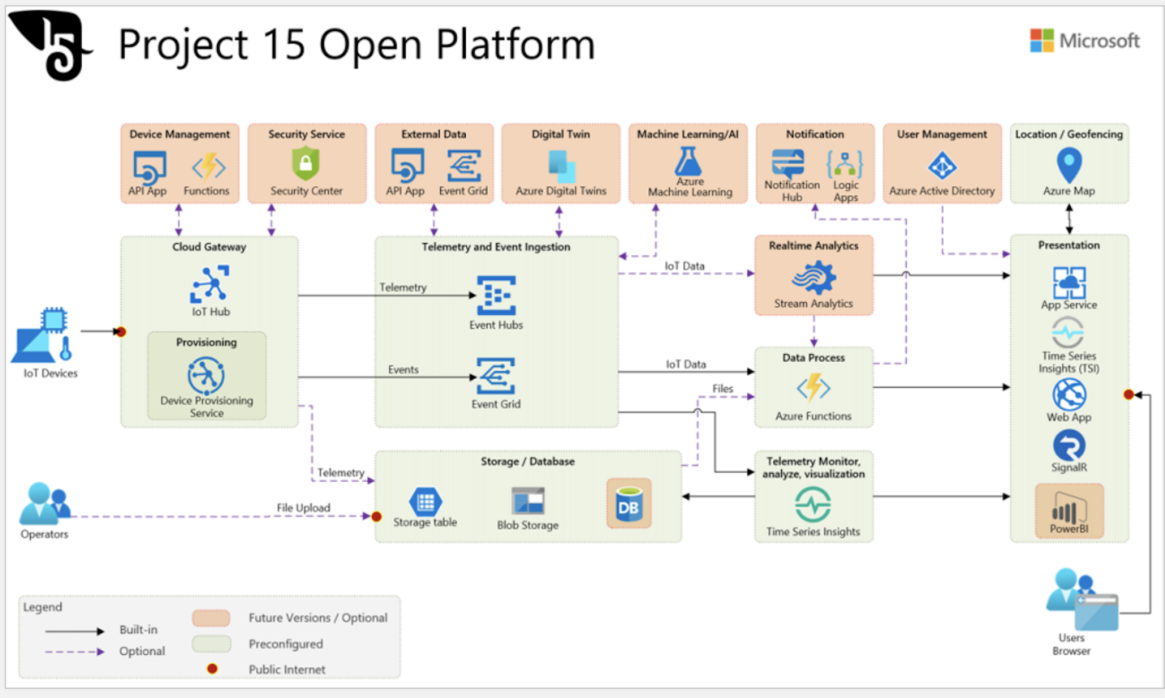

Slide 3
Research : Hunting of African Elephants
https://www.youtube.com/watch?v=nz-erwm2LrQ [Craig Boddington Hunter] Two main types of African Elephants
Bush elephants
Forest elephants
Hunting techniques vary slightly due to the social nature and other location based factors

Slide 4

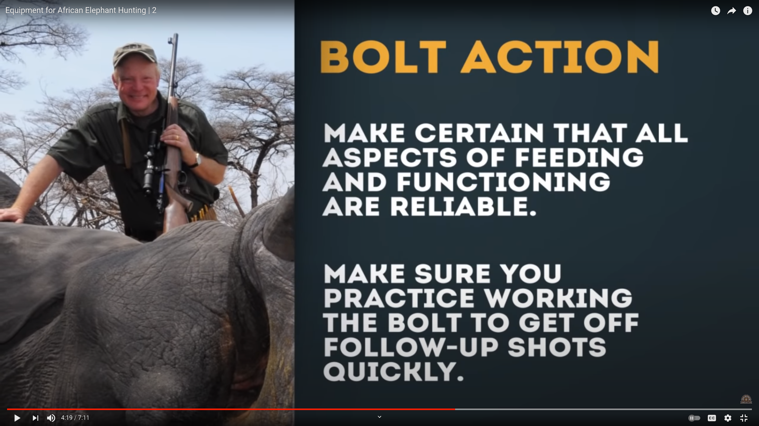
Research :Equipment for African Elephant Hunting
Hunting Rifle 375 calibre
https://www.youtube.com/watch?v=iYS2PAlXmls
https://en.wikipedia.org/wiki/Bolt_action
https://www.youtube.com/watch?v=STbDaAgcvsU

Slide 5

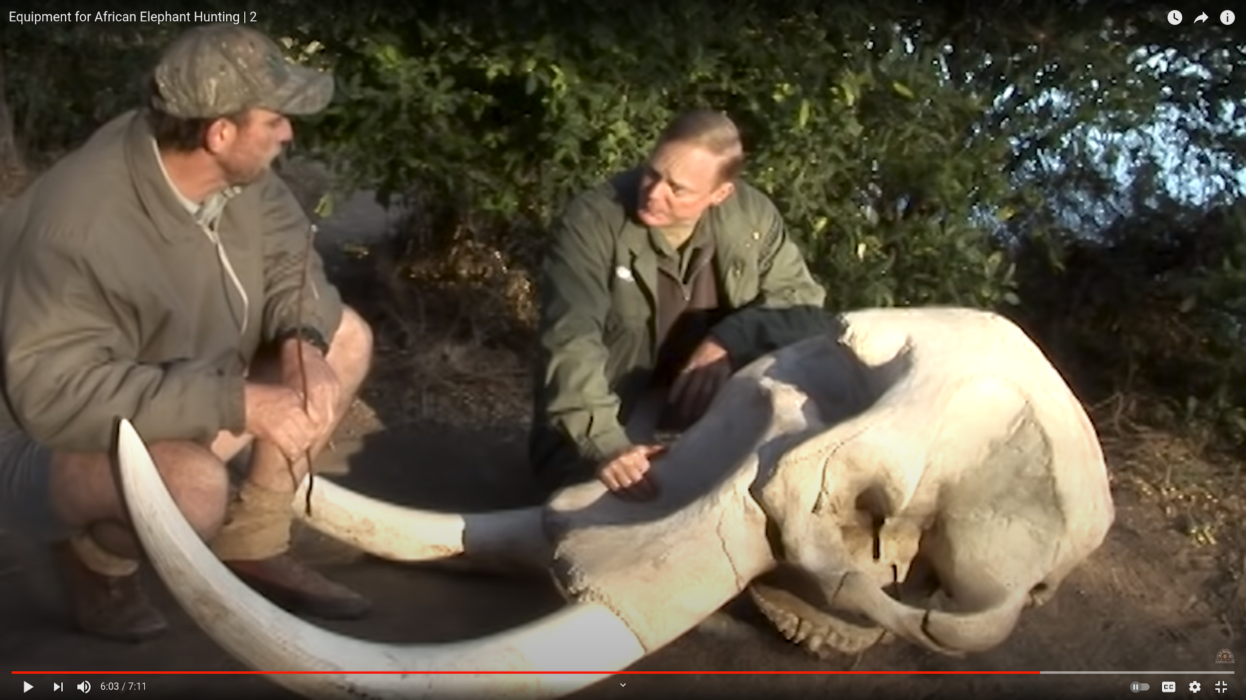

Research :Equipment for African Elephant Hunting

Slide 6
Gun shot audio effect
Sound due to a gunshot is a transient, high-energy signal which has well-deﬁned properties. These properties depend not only on the
Physical features of the ﬁrearm
Ammunition which generates the sound
Environment in which the gun is ﬁred
Direction of the microphone with respect to the ﬁrearm.
Other accessories or equipment like silencers

Slide 7
Gun shot audio effect
More speciﬁcally, a gunshot sound consists of the muzzle blast and the shock wave.
Muzzle blast is localised at the muzzle and occurs due to the explosion of the propellant in the bullet.
Shock waves occur only for bullets or projectiles which have supersonic speeds. These waves will have distinct propagation patterns following the projectile and spectra with a wide bandwidth due to the discontinuity they possess.
Procedural Synthesis of Gunshot Sounds Based on Physically Motivated Models

Slide 8
Audio feature extraction and acoustic modelling
The ear’s perception of frequency components in the audio signal does not follow the linear scale, but rather the Mel-frequency. The relation between the frequency and the Mel-frequency is given by the formula, where f is frequency in Hertz.
Mel(f) = 2595 × log10(1+f/700)
Hidden Markov Models (HMM) are a very popular classification technique for acoustic modeling of time-invariant events such as human speech, animal sounds, environmental sounds, etc. Their good recognition performance has caused the widespread use of HMM for various recognition tasks.
https://project.inria.fr/fraclab/files/2016/01/ITS2010Izabela.pdf

Slide 9
Lack of tagged data is the key problem
Efficient Model training has a minimum data requirement,
Gunshot audio data from the wildlife park is less, (<2% of tagged signals)
We have about 200 good gunshots annotated?. It is extremely time consuming to tag 24hr files.
Possible solution: Other audio data indicative of a gunshot/threat,
Rifle reloading / Bolt action
Other surrounding acoustic behaviour
Gunshot scatters flock of birds
Threatened elephant herd noises
Sensors w.r.t to probable shooting locations

Slide 10
Using Project 15
IoT Architecture for gunshot detection solution
Live monitoring of wildlife park acoustics
Alarms/ notification upon threat detection
Question:
How to get tagging for gunshot from the audio data?
How to bring filtered & tagged data into the azure cloud storage?
Note: Love the one-click Project 15 deployment. But, we probably need more Azure credits :)
https://microsoft.github.io/project15/

Slide 11
